Slide 1
Functional Groups
Chapter 11 Essential Chemistry

Slide 2

Alcohols functional group
Alcohols contain the –OH functional group. This is known as the alcohol or hydroxyl group.
The hydroxyl group is reactive and determines the chemical properties of the molecule.

Slide 3
Uses of alcohols
Drinks-The "alcohol" in alcoholic drinks is simply ethanol. methanol is poisonous, industrial methylated spirits are unfit to drink.
As a fuel-Ethanol burns to give carbon dioxide and water and can be used as a fuel in its own right, or in mixtures with petrol (gasoline). "Gasohol" is a petrol / ethanol mixture containing about 10 - 20% ethanol.
As a solvent-Ethanol is widely used as a solvent. It is relatively safe, and can be used to dissolve many organic compounds which are insoluble in water. It is used, for example, in many perfumes and cosmetics.

Slide 4
Classification of Alcohols
An alcohol can be classified as a:
Primary alcohol (also referred to as 1º alcohol)
Secondary alcohol (also referred to as 2º alcohol)
Tertiary alcohol (also referred to as 3º alcohol)
Classification of an alcohol depends on the location of the OH (hydroxyl or hydroxyl) functional group:

Slide 5
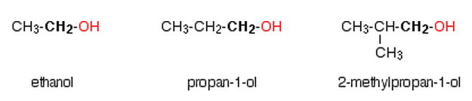
Primary Alcohols
In a primary (1°) alcohol, the carbon atom that carries the -OH group is only attached to one alkyl group. Some examples of primary alcohols are shown below:

Slide 6
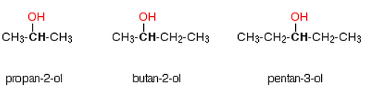
Secondary Alcohols
In a secondary (2°) alcohol, the carbon atom with the -OH group attached is joined directly to two alkyl groups, which may be the same or different. Examples include the following:

Slide 7
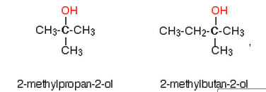
Tertiary Alcohols
In a tertiary (3°) alcohol, the carbon atom holding the -OH group is attached directly to three alkyl groups, which may be any combination of the same or different groups. Examples of tertiary alcohols are given below:

Slide 8
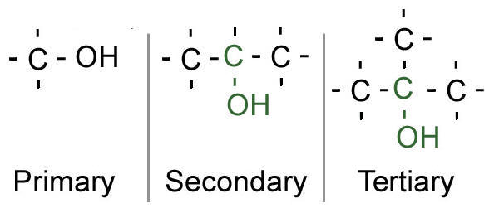
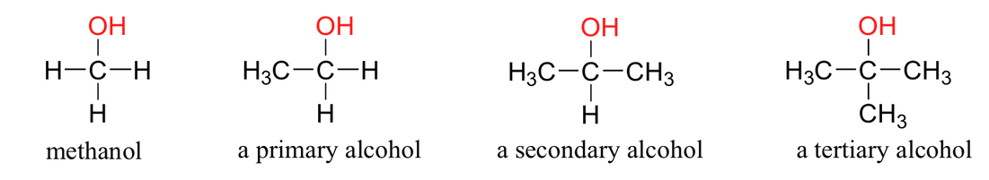
Examples of Primary, secondary and tertiary alcohols

Slide 9
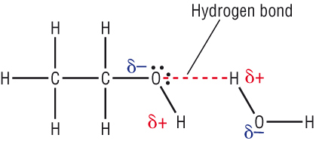
Alcohols Properties
The oxygen in the hydroxyl group is highly electronegative so creates a strong polar bond within the functional group.
The hydroxyl group can form hydrogen bonds with other polar groups, raising the melting and boiling points.
They can also form hydrogen bonds to water, increasing solubility in water. Solubility decreases as chain length increases.

Slide 10
Physical properties
The lower members of alcohols are colourless, volatile liquids with a characteristic alcoholic smell and burning taste whereas higher alcohols are odourless and tasteless.
Higher alcohols having 12 or more carbon atoms are colourless waxy solids.

Slide 11
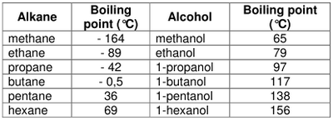
Physical Properties
Trend- boiling point increases as number of C-atoms increases.
Boiling point of any given alcohol is higher than its parent hydrocarbon. Why?? Due to hydrogen bonding.
Alcohol and the parent hydrocarbon both show an increase in B.P. as molecular mass increases, this is due increased dispersion forces.

Slide 12

Solubility in water
The first three members are completely miscible with water. The solubility rapidly decreases with increase in molecular mass. The higher members are almost insoluble in water but are soluble in organic solvents like benzene, ether etc.
The solubility of lower alcohols is due to the existence of hydrogen bonds between water and polar -OH group of alcohol molecules.
The -OH group in alcohols contain a hydrogen bonded to an electronegative oxygen atom. Thus they form hydrogen bonds with water molecules.

Slide 13
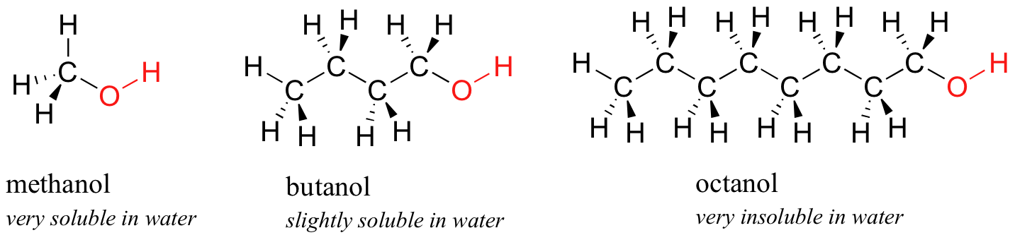
Solubility in water
Trend- Solubility in water decreases as number of C-atoms increases.
The solubility of alcohols in water decreases with increase in molecular mass because the increase in molecular mass, the non polar alkyl group becomes predominant and masks the effect of polar -OH group.
In addition, among the isomeric alcohols, the solubility increases with branching of chain. As the surface area of the non-polar part in the molecule decreases, the solubility increases.

Slide 14

Preparation of alcohols
Ethanol (primary alcohol) is commonly prepared through fermentation of simple sugars in the presence of yeast.
Hydration (addition of water) of an alkene will also produce an alcohol. The final molecule chain length depends upon the reactant alkene.

Slide 15

Reactions of alcohols
Alcohols, like all hydrocarbons, will undergo combustion in air to form carbon dioxide, water and energy.
An alcohol can have water removed chemically (dehydration) by heating in the presence of a concentrated acid.

Slide 16

Reactions of alcohols
When alcohols react with sodium they form an ion called an alkoxide where the hydrogen ion is removed from the hydroxyl group leaving the hydrocarbon with an O– ion. Hydrogen gas also forms.
In this reaction, the ethanol acts like an acid, donating its hydrogen ion.

Slide 17
Redox in Organic chemistry
Normally: Oxidation is a loss of electrons; Reduction is a gain of electrons.
But in organic terms:
Oxidation: loss of H₂; addition of O or O₂; addition of X₂ (halogens).
Reduction: addition of H₂ or H- ; loss of O or O₂; loss of X₂. (Neither an oxidation nor reduction: Addition or loss of H+ , H₂O, HX).

Slide 18
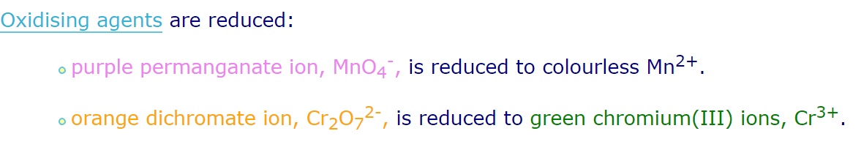
Oxidation of Alcohols
In the lab controlled oxidation of alcohol is used to synthesise other organic compounds like aldehydes, ketone and carboxylic acids.
This achieved by using oxidising agents like acidified KMnO₄ _{(aq),} K₂Cr₂O_{7(aq)}

Slide 19

Oxidation of 1° Alcohols
Primary alcohols will oxidise when in the presence of a strong oxidising agent such as acidified permanganate ions (MnO₄–) or acidified dichromate ions (Cr₂O₇^{2–}).
They oxidise to form an aldehyde, which is then further oxidised to a carboxylic acid.
[O] = oxidation has occurred.

Slide 20
Partial oxidation of Primary Alcohols
It difficult to achieve because there is a strong tendency for aldehydes to oxidised to carboxylic acids.
Partial oxidation is favoured by using excess alcohol and a weak oxidising agent like K₂Cr₂O₇ _{(aq),} and distil off the aldehyde as soon as it forms.
The excess of the alcohol means that there isn't enough oxidising agent present to carry out the second stage. Removing the aldehyde as soon as it is formed means that it doesn't hang around waiting to be oxidised anyway!

Slide 21
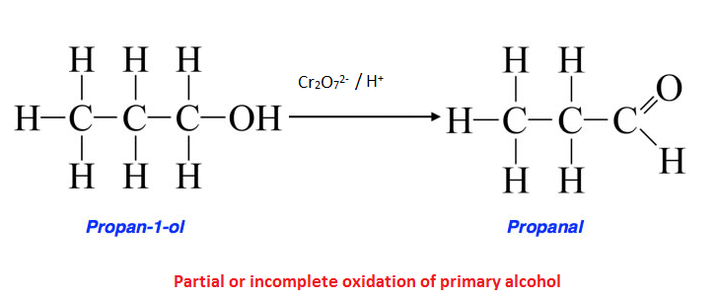
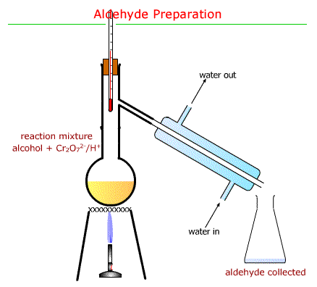

Slide 22
Question?
Write down the half oxidation and reduction reaction, and the full redox reaction of propan-1-ol using acidified potassium permanganate KMnO₄ and potassium dichromate K₂Cr₂O_{7.}

Slide 23

Reduction reaction-
CH₃CH₂CH₂OH → CH₃CH₂CHO +2H⁺ + 2e⁻ (*5)
Full redox reaction-
Oxidation reaction

Slide 24
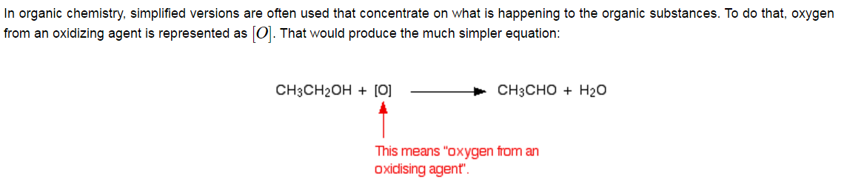
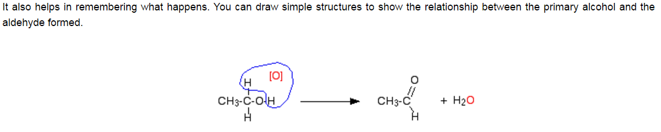

Slide 25

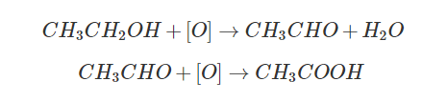
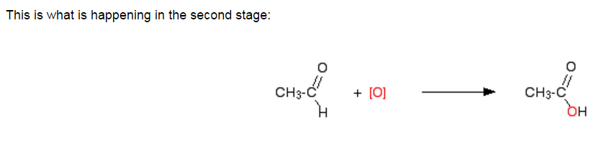
Complete Oxidation of Primary Alcohol
Overall reaction-

Slide 26
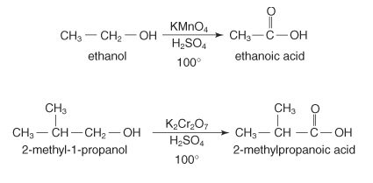
Complete oxidation of primary alcohol
1. Excess of oxidising agents like KMnO₄ and Kr₂Cr₂O₇

Slide 27

Oxidation of Secondary alcohols
Secondary alcohols oxidise to form ketones. There is no further oxidation of a ketone.
Tertiary alcohols do not oxidise.
This reaction can be used to distinguish a tertiary alcohol from a primary/secondary alcohol as the oxidising agents show a distinct colour change when a reaction occurs. For example, dichromate ions (orange) form chromium ions (green).
Notes:
Experiment 6.2 – Distinguishing between primary, secondary and tertiary alcohols

Slide 28
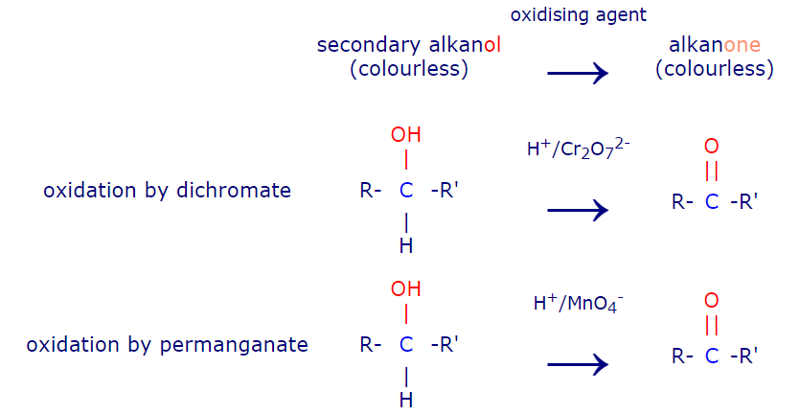
Oxidation of secondary alcohols

Slide 29
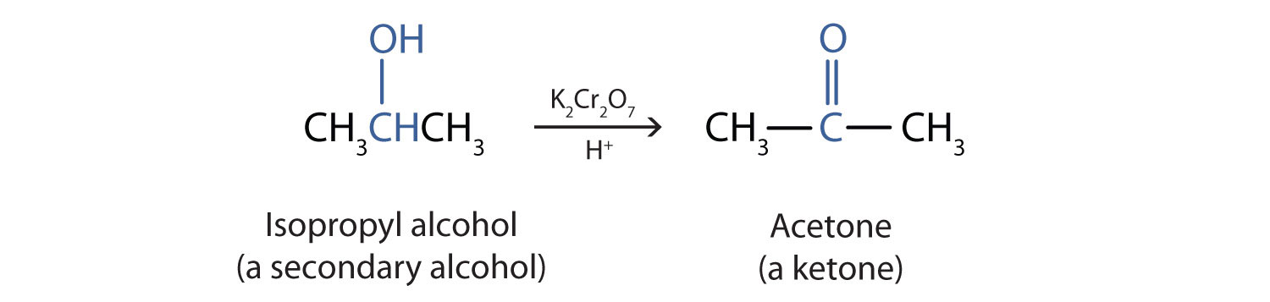
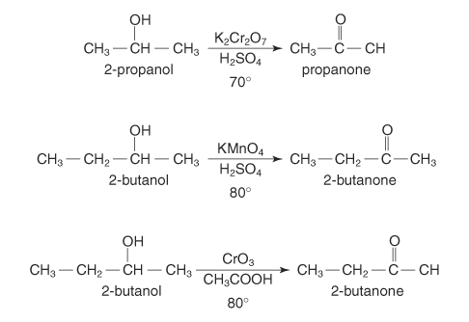
Examples

Slide 30
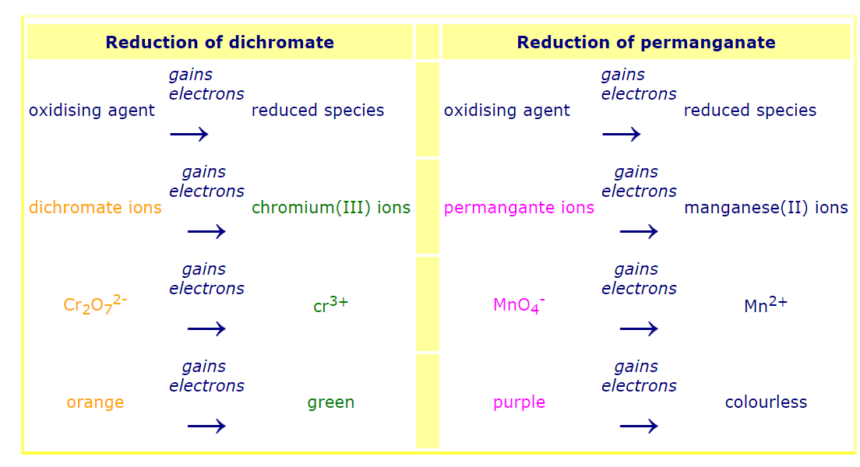
Reduction summary of oxidising agents

Slide 31
Polarity and Boiling Point:
The polarity of the molecules determines the forces of attraction between the molecules in the liquid state. Polar molecules are attracted by the opposite charge effect (the positive end of one molecule is attracted to the negative end of another molecule. Molecules have different degrees of polarity as determined by the functional group present.
Principle: The greater the forces of attraction the higher the boiling point or the greater the polarity the higher the boiling point.

Slide 32
Aldehydes and ketones
Aldehydes and ketones as carbonyl compounds A carbon with a double bond to an oxygen atom is a carbonyl group.
Aldehydes and ketones are simple compounds which contain a carbonyl group - a carbon-oxygen double bond. >C=O
In aldehydes, the carbonyl group has a hydrogen atom attached to it

Slide 33
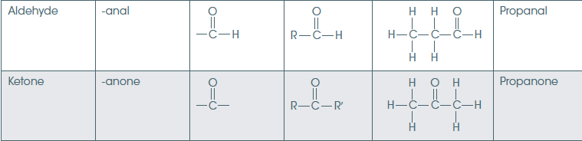
Aldehyde/ketone group Nomenclature
In the aldehyde the carbonyl is terminal (at the end of the chain). In the ketone the carbonyl is on a carbon in the middle of the chain.

Slide 34
Naming aldehydes and ketones
1 Locate the longest carbon chain that contains the carbonyl group.
2 Delete the ‘e’ from the alkane and add ‘al’ for an aldehyde and ‘one’ for a ketone.
3 Number the carbons in the chain so the carbonyl group has the smallest number, the aldehyde will always be a 1 so does not need to be allocated a number. Number the ketone according to position: 2-butanone
4 Name any alkyl side chains according to position and length: 3-methyl-2-butanone

Slide 35

Aldehydes and Ketones
Bonding and reactivity
Bonding in the carbonyl group
Oxygen is far more electronegative than carbon and so has a strong tendency to pull electrons in a carbon-oxygen bond towards itself. One of the two pairs of electrons that make up a carbon-oxygen double bond is even more easily pulled towards the oxygen. That makes the carbon-oxygen double bond very highly polar.

Slide 36
Physical Properties of aldehydes and ketones
The carbonyl group is highly polar because of the electronegativity difference between the carbon and oxygen atoms.
Dipole-dipole bonds form between molecules with carbonyl groups giving higher melting and boiling points than simple hydrocarbon molecules with dispersion forces.
As the carbonyl group can also form bonds with water, smaller aldehydes and ketones are water soluble.

Slide 37
Aldehydes physical properties
Boiling points
Methanal is a gas (boiling point -21°C), and ethanal has a boiling point of +21°C. That means that ethanal boils at close to room temperature.
The other aldehydes are liquids, with boiling points rising as the molecules get bigger.
The size of the boiling point is governed by the strengths of the intermolecular forces.

Slide 38
van der Waals & dipole-dipole attractions
Both aldehydes and ketones are polar molecules because of the presence of the carbon-oxygen double bond. As well as the dispersion forces, there will also be attractions between the permanent dipoles on nearby molecules.
That means that the boiling points will be higher than those of similarly sized hydrocarbons - which only have dispersion forces.

Slide 39
It is interesting to compare three similarly sized molecules. They have similar lengths, and similar (although not identical) numbers of electrons.
molecule | type | boiling point (°C)
CH₃CH₂CH₃ | alkane | -42
CH₃CHO | aldehyde | +21
CH₃CH₂OH | alcohol | +78
Notice that the aldehyde (with dipole-dipole attractions as well as dispersion forces) has a boiling point higher than the similarly sized alkane which only has dispersion forces.
However, the aldehyde's boiling point isn't as high as the alcohol's. In the alcohol, there is hydrogen bonding as well as the other two kinds of intermolecular attraction.
Although the aldehydes and ketones are highly polar molecules, they don't have any hydrogen atoms attached directly to the oxygen, and so they can't hydrogen bond with each other.

Slide 40
Solubility in water
The small aldehydes are freely soluble in water but solubility falls with chain length. For example, methanal, ethanal and the common small aldehydes - are miscible with water in all proportions.
The reason for the solubility is that although aldehydes can't hydrogen bond with themselves, they can hydrogen bond with water molecules.

Slide 41
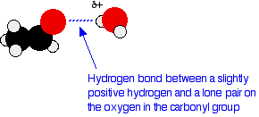
One of the slightly positive hydrogen atoms in a water molecule can be sufficiently attracted to one of the lone pairs on the oxygen atom of an aldehyde for a hydrogen bond to be formed.
There will be dispersion forces and dipole-dipole attractions between the aldehyde and the water molecules.
Forming these attractions releases energy which helps to supply the energy needed to separate the water molecules and aldehyde molecules from each other before they can mix together.
As chain lengths increase, the hydrocarbon "tails" of the molecules start to get in the way.
By forcing themselves between water molecules, they break the relatively strong hydrogen bonds between water molecules without replacing them by anything as good. This makes the process energetically less profitable, and so solubility decreases.

Slide 42
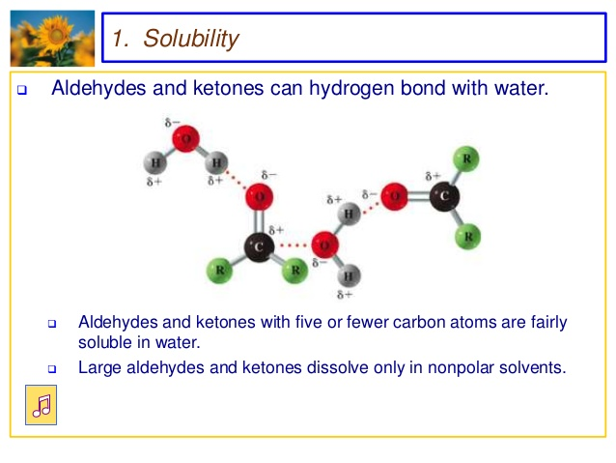

Slide 43
Properties of Ketones
Dipole-dipole forces due to the presence of carbonyl group.
B.P. increases with chain length.
Solubility decreases with increase chain.
Eg- propanone is a liquid at room temperature, soluble in water whereas hexane-3-one is slightly soluble.

Slide 44
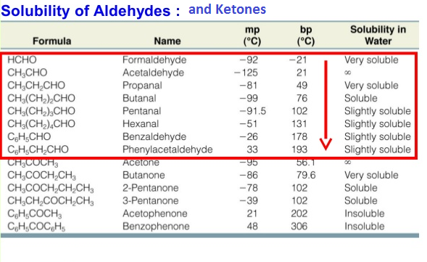

Slide 45
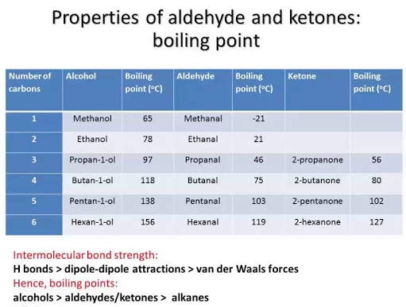

Slide 46
Summary of physical properties
KETONES and ALDEHYDE: A comparison of the boiling points of aldehyde and ketone with the corresponding alcohol shows that the alcohol is more polar due to its ability to hydrogen bond. Since ketones and aldehydes lack hydroxyl groups, they are incapable of intermolecular hydrogen bonds. But due to the presence of the oxygen, they can accept hydrogen bonds from water molecules which account for the complete solubility of low molecular weight compounds.
On the other hand, their boiling points are considerable higher than the ether or alkane, indicating the presence of weak intermolecular dipole-dipole forces. The carbonyl group ("carbon double bond oxygen") is polar since oxygen is more electronegative than carbon and forms a partially charged dipole

Slide 47
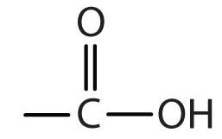
Carboxylic acids
contain a -COOH group. Carboxyl group (carbonyl + hydroxyl group)
A carbon atom double bonded to an oxygen atom is a carbonyl group.
A hydrogen atom bonded to an oxygen atom is a hydroxyl group .
These compounds are higher in the polarity with alcohols, because of hydrogen bonding capabilities and the presence of two oxygen atoms.

Slide 48


Carboxylic acids
Carboxylic acids contain the carboxyl functional group – COOH.
The functional group is always on the end of the carbon chain.

Slide 49
Naming carboxylic acids
1 Identify the longest carbon chain that contains the carboxyl group.
2 Remove the ‘e’ of the alkane and add ‘oic acid’. For example propane becomes propanoic acid.
3 Number the carbons with the carboxyl group allocated the 1 carbon.
4 Name and number any alkyl side chains.

Slide 50
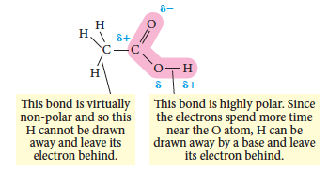
Properties of carboxylic acids
The carboxyl group can donate a hydrogen ion so acts as an acid. It undergoes normal acid-base reactions.
The carboxyl group contains a highly polar –OH bond which allows this to happen.

Slide 51
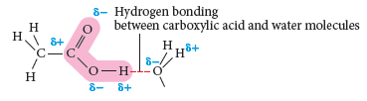
Properties of carboxylic acids
The polar carboxyl group can form hydrogen bonds with other carboxyl groups so these molecules have relatively high melting and boiling points.
The carboxyl group can also form hydrogen bonds with water, so when the carbon chain is small carboxylic acids are soluble. As the carbon chain gets longer, the acids become less soluble and insoluble.

Slide 52
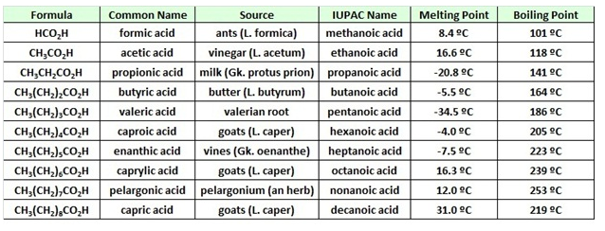
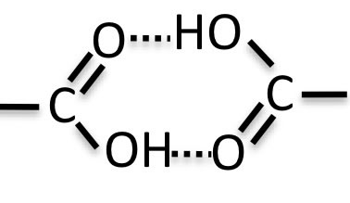
Trends in B.P.
B.P. increases as the chain increases.
Hydrogen bonding in carboxylic acid.

Slide 53
Boiling points
The boiling points of carboxylic acids of similar size are higher still.
For example:
propan-1-ol | CH₃CH₂CH₂OH
ethanoic acid | CH₃COOH
propan-1-ol | CH₃CH₂CH₂OH
These are chosen for comparison because they have identical relative molecular masses and almost the same number of electrons (which affects van der Waals dispersion forces).

Slide 54
Solubility in water
Small chain are soluble in polar solvents like water and alcohols.
Large chain are insoluble in water but soluble in non polar solvents like benzene.
Long chain carboxylic acids are known as fatty acids. They are greasy to touch, insoluble in water and found naturally in plants and animals.

Slide 55
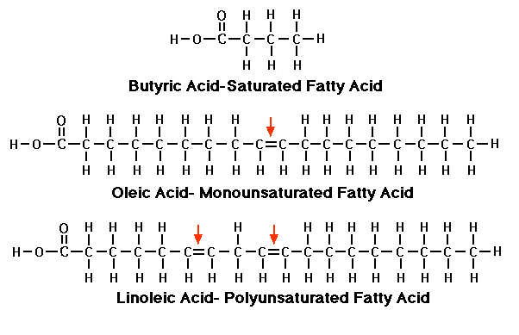
Saturated and unsaturated Fatty acids

Slide 56
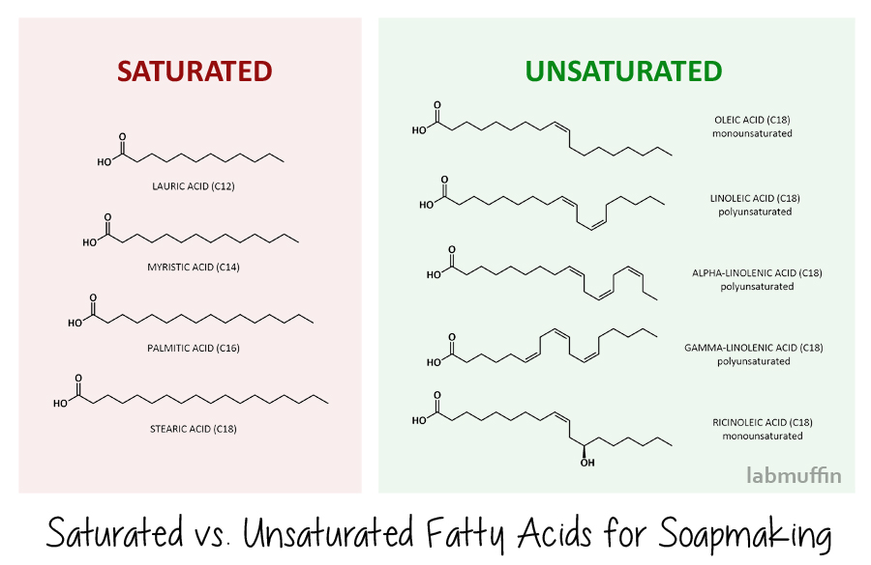
Examples of long chain fatty acids

Slide 57
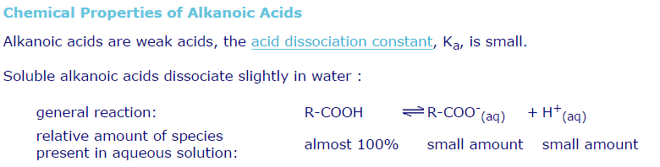
Chemical properties of Carboxylic acids

Slide 58
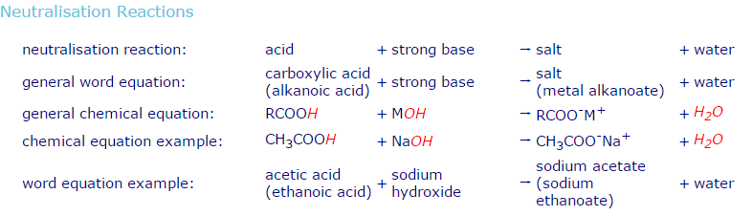
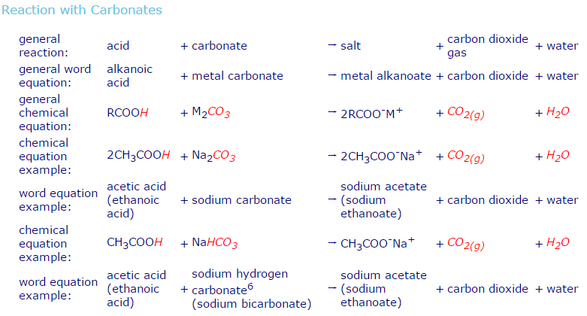

Slide 59
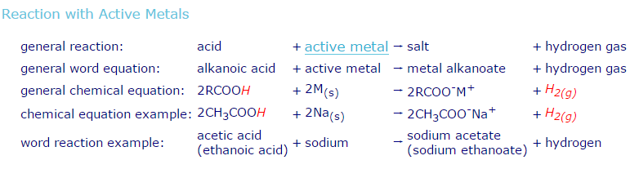

Slide 60
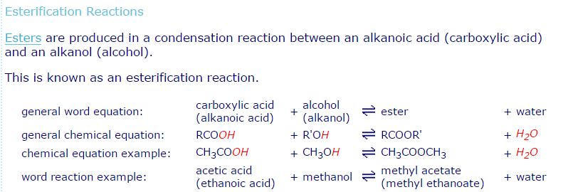

Slide 61
Reactions of carboxylic acids
React with active metals to produce a salt and hydrogen gas:
React with a base in a neutralisation reaction to form a salt and water:

Slide 62
Reactions of carboxylic acids
If a metal carbonate is added then a salt and water and carbon dioxide are produced:
Addition of an alcohol with specific conditions produces an ester, another organic compound.

Slide 63
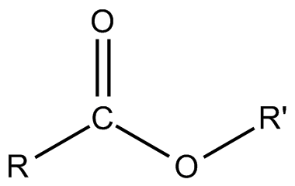
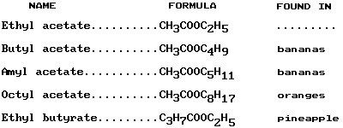
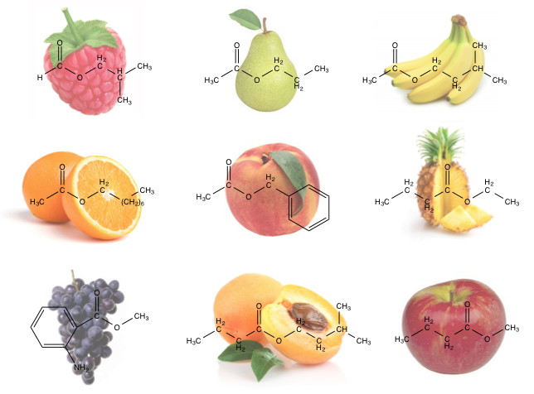
Esters-are chemicals with pleasant smells. They are used in perfumes, and as solvents.

Slide 64
Esters
Esters are chemicals with pleasant smells. They are used in perfumes, and as solvents.
An ester is made from an alcohol and a carboxylic acid.
Esters have their own rules for naming.
The first part of the name comes from the alcohol, and it ends with the letters '-yl'.
The second part of the name comes from the carboxylic acid, and it ends with the letters '-oate'.

Slide 65

What is an ester?
The ester functional group contains a carbon with a double bond to an oxygen and a separate single bond to another oxygen.
The group is in the middle of a carbon chain.

Slide 66
Synthesizing esters
An alcohol and a carboxylic acid can be used to synthesise an ester.
Natural esters form very slowly. To speed up the reaction, the reaction is heated and a catalyst is used. Concentrated sulfuric acid is commonly used as the catalyst for this reaction.
This process is called esterification. A general equation for this process is:

Slide 67
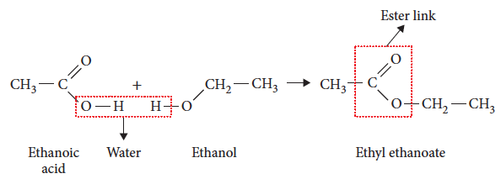
Synthesizing esters
This reaction is an example of a condensation reaction. A molecule of water is formed as well as the ester.

Slide 68
Naming esters
Naming esters involves looking at the alcohol and carboxylic acid from which it was formed.
The first part of the name describes the alkyl group and comes from the alcohol it is formed from. This is the carbon chain attached to the oxygen within the chain. Example: ethyl, propyl
The second part is from the carboxylic acid. The end of the acid name is changed from ‘oic acid’ to ‘oate’. Example: butanoate, heptanoate
Notes:
Examples of names are in Table C6.7

Slide 69
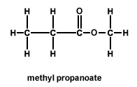
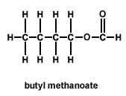
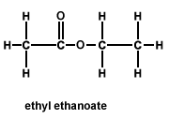

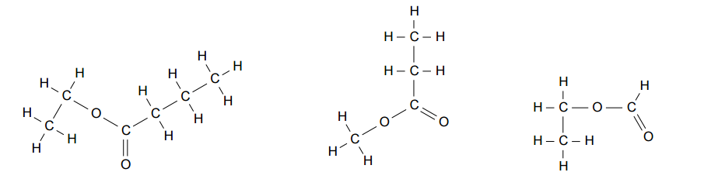
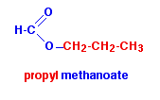
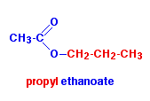


Naming Examples
Name the following esters

Slide 70
Properties
The polar C=O and C-O bonds make the ester group polar. They only form dipole–dipole bonds between molecules.
Their melting and boiling points are higher than hydrocarbons, but lower than alcohols or carboxylic acids of similar size.
They do not form hydrogen bonds with water so are not soluble in water. Many esters are soluble in organic solvents.

Slide 71
Polarity of Esters
ESTER: The ester functional group has a similar character to the ketone and aldehyde functional group. The boiling point indicates that it is the least polar of the three.

Slide 72
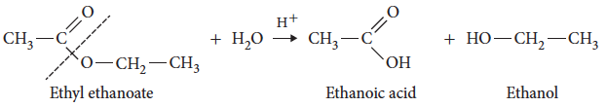
Reactions – acid hydrolysis
Acid hydrolysis of an ester involves reversing the formation reaction.
An acid is added, the mixture is heated and the ester splits to form an alcohol and carboxylic acid.

Slide 73
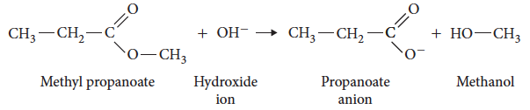
Reactions – alkaline hydrolysis
The splitting or hydrolysis of an ester can also be performed by adding a base and heating the mixture.

Slide 74
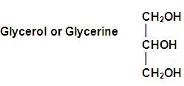

Fats and oils
Fats and oils are esters called triglycerides.
A triglyceride that is solid at room temperature is a fat, while one that is a liquid at room temperature is an oil.
A triglyceride has three ester groups in the molecule and is formed from the alcohol 1,2,3-propantriol (commonly called glycerol) and three, long chain fatty acids.

Slide 75

Synthesis of Triglyceride

Slide 76

Production of a fat/oil
A fatty acid undergoes an esterification with one of the alcohol groups in glycerol.

Slide 77


Hydrolysis of a fat/oil
Reversal of the formation reaction occurs when water is added to the fat/oil.
Notes:
Experiment 6.3 – Preparation of some esters.

Slide 78
Amines and Amides

Slide 79

What is an amine?
Amines are based on the ammonia molecule and contain the functional group –NH₂.
The hydrogen atoms on an ammonia molecule are replaced by alkyl groups to create amine molecules.

Slide 80


Primary, secondary and tertiary amines
Amines are classified as primary, secondary or tertiary based on the number of alkyl groups attached to the nitrogen atom.
A primary amine (a) has one alkyl group, while a secondary amine (b) has two alkyl groups.

Slide 81



Slide 82
Naming amines
1 Put the alkyl groups attached to the N atom into alphabetical order. Use the alkyl name for all except the final group.
2 Remove the ‘e’ from the last alkane name and add ‘amine’. Example: ethylmethanamine
3 Use di- and tri- if there are multiple identical alkyl groups.
4 Number the carbons, allocating the amine the lowest possible number.
5 Name any other side chains as for naming alkanes.

Slide 83

Practice naming

Slide 84
Properties of amines
The –NH₂ amine group is highly polar because of the large electronegativity difference between nitrogen and hydrogen.
This gives amines relatively high melting and boiling points as it can form hydrogen bonds between molecules.
Small primary and secondary amines are also soluble in water due to formation of hydrogen bonds.

Slide 85
Polarity of amines
AMINE : The polarity of the amine nitrogen is shown to be much less than the oxygen in alcohol group. The nitrogen in the amine is much less electronegative than oxygen in the alcohol. Therefore, the dipole on N-H is much weaker than the dipole on O-H

Slide 86

Basicity of Amines
A base is: a substance which combines with hydrogen ions. This is the Bronsted-Lowry theory.
an electron pair donor. This is the Lewis theory.
Amines are bases due to the lone pair of electrons on the nitrogen atom of amines. These react with water to form hydroxyl ions. Bases are those species that donate OH- ions (hydroxyl ions). The more easily is the availability of the hydroxyl ions; more is the basicity of the amine.
Let us now, explore and diagnose the order of basicity in amines.

Slide 87


Slide 88


Reactions of amines
As amines are weak bases, they will participate in neutralisation reactions with acids.

Slide 89


Slide 90


Amides
An amide contains a functional group that is part carboxylic acid C=O and part amine –NH.

Slide 91
Naming amides
1 Change the ending of the carboxylic acid name from ‘oic acid’ to ‘amide’. Example: propanoic acid becomes propanamide
2 Alkyl groups bonded to the nitrogen atom become N-alkyl. Example: N- ethylpropanamide

Slide 92
Preparation of an amide
Reaction of a carboxylic acid with an ammonium salt producing a salt, water and carbon dioxide.
The products are heated to dehydrate the salt, producing a primary amide.

Slide 93

Preparation of an amide
Secondary amides are made when carboxylic acids and amines react together, a water molecule is eliminated. This is a condensation reaction.

Slide 94

Properties of Amides
The amide are the most polar. The reason is that it can both hydrogen bond and accept hydrogen bonds on both the oxygen and the nitrogen.
High boiling and melting point as compare to carboxylic acids and alcohols.
Soluble in water.
Solids at room temp.

Slide 95
Amide reactions
Hydrolysis of amides will result in formation of a carboxylic acid and amine.
This will occur under both acid and base conditions:
Under acidic conditions, in the presence of heat and dilute acid
CH₃-CO-NH₂ + H₂O+ HCl → CH₃COOH + NH₄Cl
Under alkaline conditions, in the presence of heat and sodium hydroxide
CH₃-CO-NH₂ + NaOH → CH₃COONa + NH₃

